Slide 1
RE-RASSOR ARM
Grace Busch | Evaline Cantarero | Jackson Davis | David Nowicki
TEAM 505

Slide 2
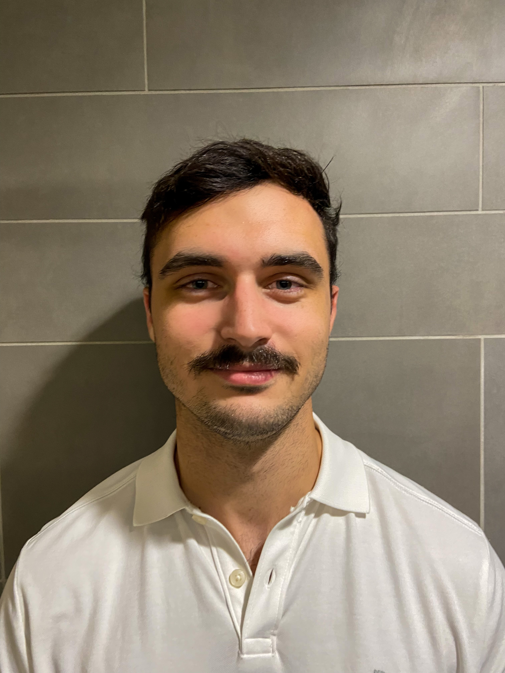
Meet Team 505
Grace Busch
Dynamic System
Engineer
Evaline Cantarero
Mechatronics
Engineer
Jackson Davis
Materials Engineer
David Nowicki
Design
Engineer

Slide 3
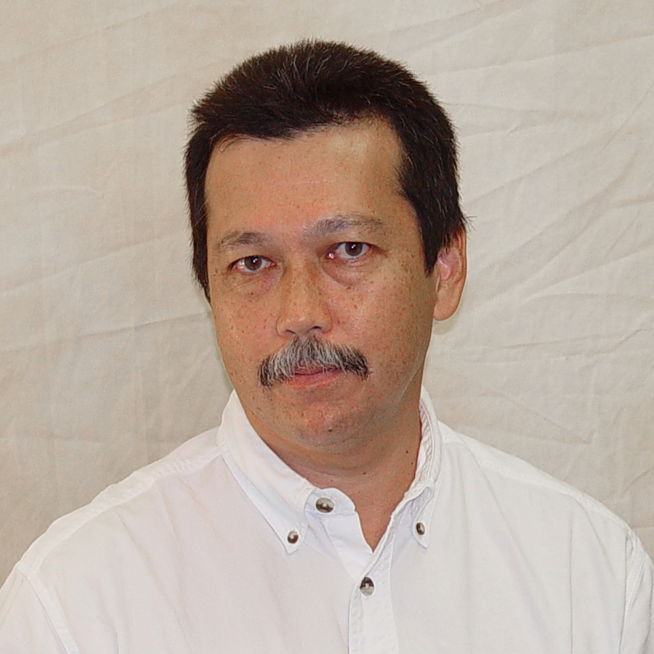
Sponsor and Advisor
Engineering Mentor
Mike Conroy
Florida Space Institute
Academic Advisor
Dr. Patrick Hollis
FAMU-FSU College of Engineering

Slide 4
Project Background
Scaled down version of NASA’s
Focused on the arm and shoulder joint
Excavate in different gravities
Navigate tough terrain carrying a load

Slide 5
Objectives
Budget Friendly
Provide large enough torque
Penetrate and excavate the ground
Travel with samples
Select materials and design that will endure the stress, load, and strain

Slide 6
Customer Needs

Slide 7
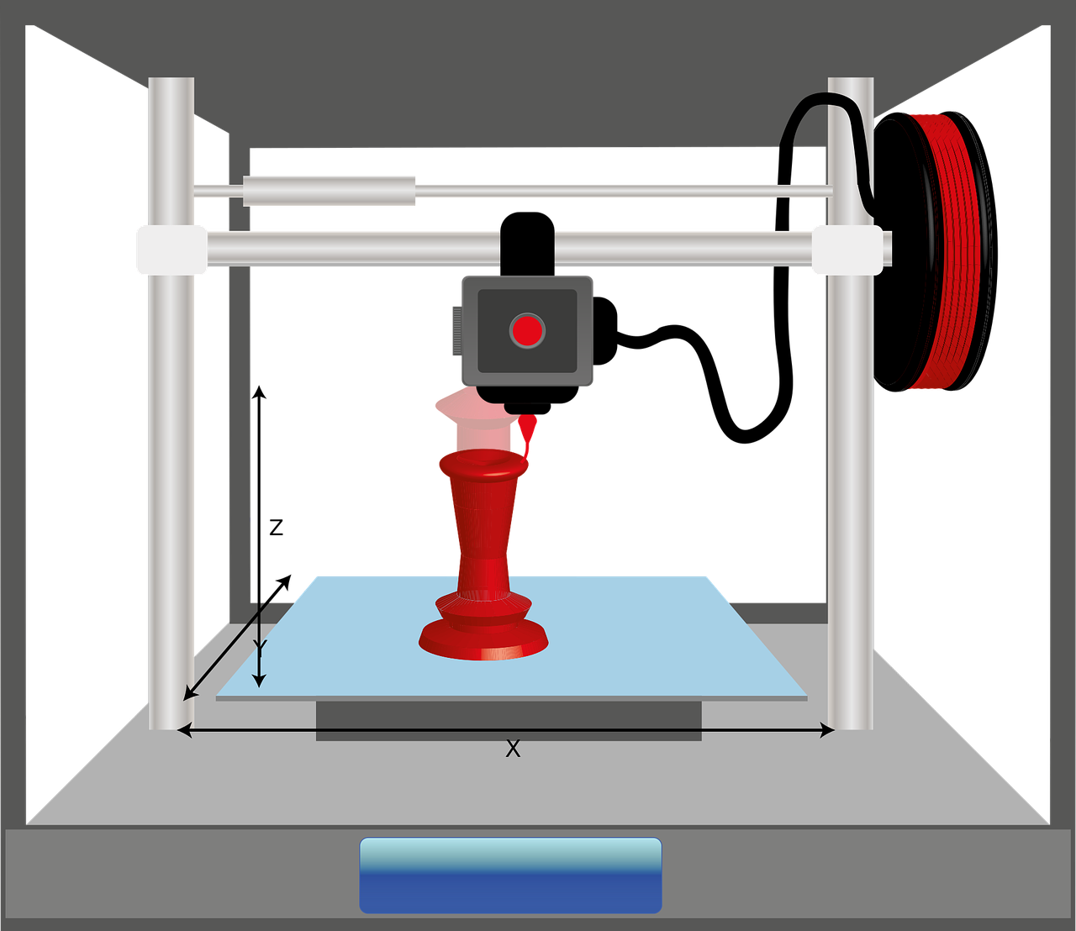
Customer Needs
COST
EQUIPMENT
MOTION
REQUIREMENTS

Slide 8
Customer Needs
COST
3D print as many parts that can
excluding bearing, screws, motors, etc.
Filaments:
Structural Carbon fiber
Nylon
ABS (Acrylonitrile Butadiene Styrene)
Stay away from PLA (Polylactic Acid)
REQUIREMENTS
MOTION
EQUIPMENT
MATERIAL
MOTION
QUALITY
Withstand Earth atmosphere, room temperature, and outside temperatures
Doesn’t need to withstand launch environment or space environment
Easy to replicate
Lift the arm up and down with both full and empty drum
Gearbox and motor capable to move the arm
Arm be able to move form one side of the robot to the other
NASA: $12,000
Gearbox: $1,000
Entire Robot: $500-$1,000
Shoulder Joint: $50-$60

Slide 9
Project Scope

Slide 10
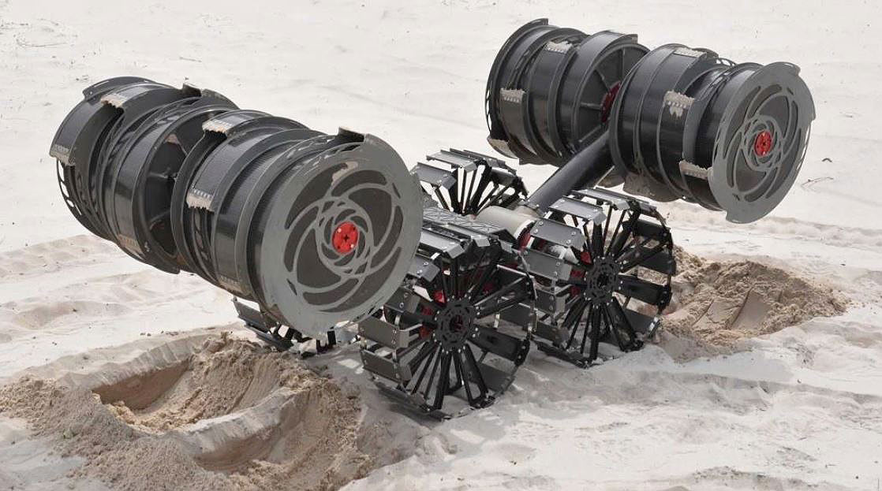
What We Are Working On?
Shoulder
Drives the system
Gearbox
Motor
Arm
Connects the shoulder to the drum
Supports the drum in all operations

Slide 11
Assumptions
The system will operate at 12 volts
The entire system will be operated by Arduino
The system does not need to be sealed
The system will only move in one dimensional up and down motion
Design for Earth's environment
1D

Slide 12
Our Primary Market

Slide 13
Our Secondary Market

Slide 14
Our Stakeholders

Slide 15
Our Stakeholders
Mike Conroy
Dr. Patrick Hollis

Slide 16
Functional Decomposition

Slide 17
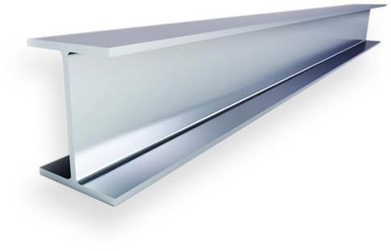
Functional Decomposition
SOURCE POWER
SUPPORT ARM
CREATE MOTION

Slide 18
Functional Decomposition
UP AND DOWN TRANSLATION OF THE ARM
CONVERT ELECTRICAL ENERGY INTO MECHANICAL ENERGY
SUPPORT LOADS FROM GEARBOX AND MOTOR
WITHSTAND FORCES IMPOSED BY ENVIRONMENT WHILE WORKING
CREATE MOTION
SUPPORT ARM
CREATE MOTION
SOURCE POWER
SUPPORT ARM
MOVE ARM THROUGH 270° OF MOTION REGARDLESS OF LOAD
MAINTAIN LOCATION OF DRIVE COMPONENTS WITH RESPECT TO ARM
TRANSMIT AND CONDITION DC POWER FROM BATTERIES TO DRIVER
DIGGING - CLIMBING - MOVING

Slide 19
Future Timeline
TARGET & METRICS
CONCEPT EVALUATION
CONCEPT GENERATION
CONCEPT SELECTION

Slide 20
Future Timeline
RISK ASSESSMENT
BILL OF MATERIALS
TRIAL AND ERROR
FINAL PRODUCT

Slide 21
Reference
Showcase, A. P. (2021, August 6). 2020 RE-RASSOR ARM. Florida Space Institute. Retrieved September 13, 2021, from https://fsi.ucf.edu/2020re-rassorarm/.
Showcase, A. P. (2021, August 6). 2020 RE-RASSOR Gold team. Florida Space Institute. Retrieved September 13, 2021, from https://fsi.ucf.edu/2020goldteam/.

Slide 22
Backup Slides

Slide 23
Customer Needs
COST
3D print as many parts that can
excluding bearing, screws, motors, etc.
Filaments:
Structural Carbon fiber
Nylon
ABS (Acrylonitrile Butadiene Styrene)
Stay away from PLA (Polylactic Acid)
EQUIPMENT
MATERIAL
MOTION
QUALITY

Slide 24
Customer Needs
MOTION
MATERIAL
MATERIAL
MOTION
QUALITY
Lift the arm up and down with both full and empty drum
Gearbox and motor capable to move the arm
Arm be able to move form one side of the robot to the other

Slide 25
Customer Needs
REQUIREMENTS
MOTION
MATERIAL
MOTION
QUALITY
Withstand Earth atmosphere, room temperature, and outside temperatures
Doesn’t need to withstand launch environment or space environment
Easy to replicate

Slide 26
Functional Decomposition
WITHSTAND FORCES IMPOSED BY ENVIRONMENT WHILE WORKING
SOURCE POWER
SUPPORT ARM
CREATE MOTION
SUPPORT ARM
DIGGING - CLIMBING - MOVING

Slide 27
Functional Decomposition
SUPPORT LOADS FROM GEARBOX AND MOTOR
SUPPORT ARM
MAINTAIN LOCATION OF DRIVE COMPONENTS WITH RESPECT TO ARM

Slide 28
Functional Decomposition
CREATE MOTION
UP AND DOWN TRANSLATION OF THE ARM
SUPPORT ARM
SUPPORT ARM
CREATE MOTION
MOVE ARM THROUGH 270° OF MOTION REGARDLESS OF LOAD

Slide 30
Concept Generation

Slide 31
Concept Selection

Slide 32
Embodiment
Upcoming Presenter’s Name

Slide 33
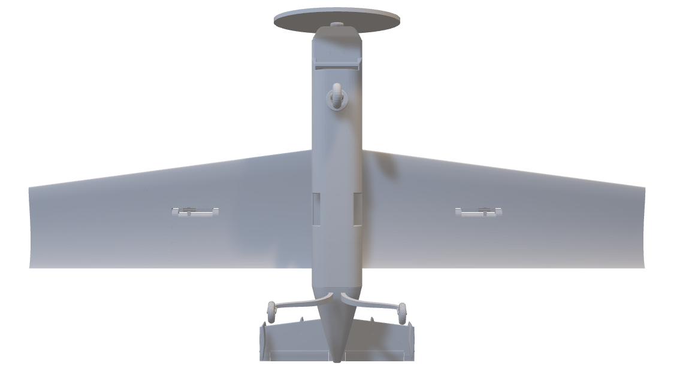

Slide 34
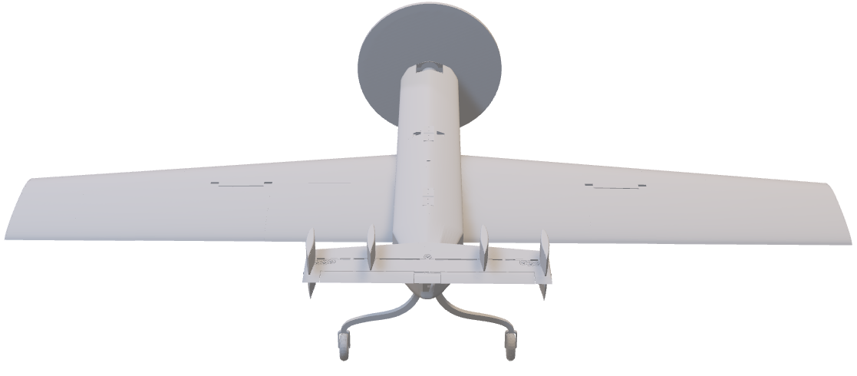

Slide 35
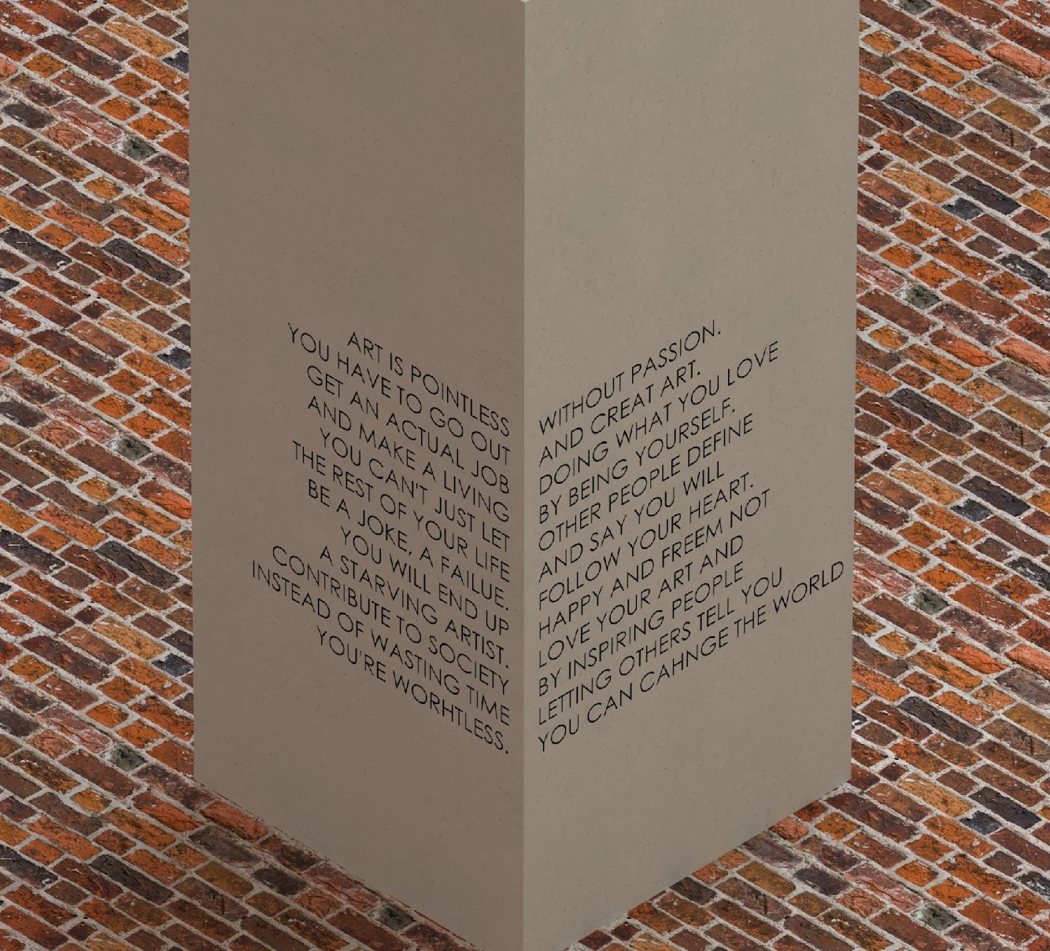

Slide 36
Manufacturing
Upcoming Presenter’s Name

Slide 38
Testing
Upcoming Presenter’s Name

Slide 40
Project Management

Slide 41
# Most Important Points
The quick brown fox jumps over the lazy dog.
The quick brown fox jumps over the lazy dog.
The quick brown fox jumps over the lazy dog.
The quick brown fox jumps over the lazy dog.
The quick brown fox jumps over the lazy dog.
The quick brown fox jumps over the lazy dog.

Slide 42
Lessons Learned

Slide 43
Functional Decomp Backup

Slide 46
Concept Selection Backup

Slide 49
Detailed Math Backup

Slide 52
Standard Shapes
Summary Box
Text box 1
Outlined Text Box

Slide 53
Approved Logos

Slide 54
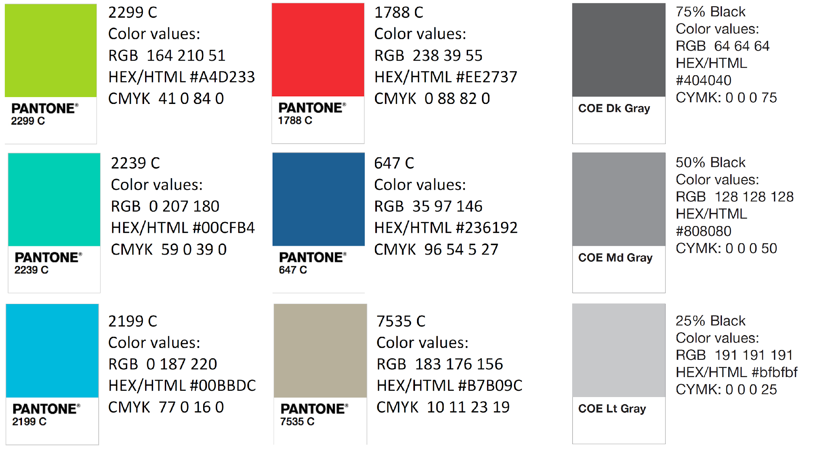
Color Palette

Slide 55
APA Tables
Category 1 | Category 2 | Category 3 | Category 4 | Category 5
Item 1
Item 2
Item 3
Item 4
 | Category 2 |  |  | Category 3
Category 1 | subcategory 1 | subcategory 2 |  | subcategory 1 | subcategory 2
Item 1
Item 2
Item 3
Item 4

